Slide 1


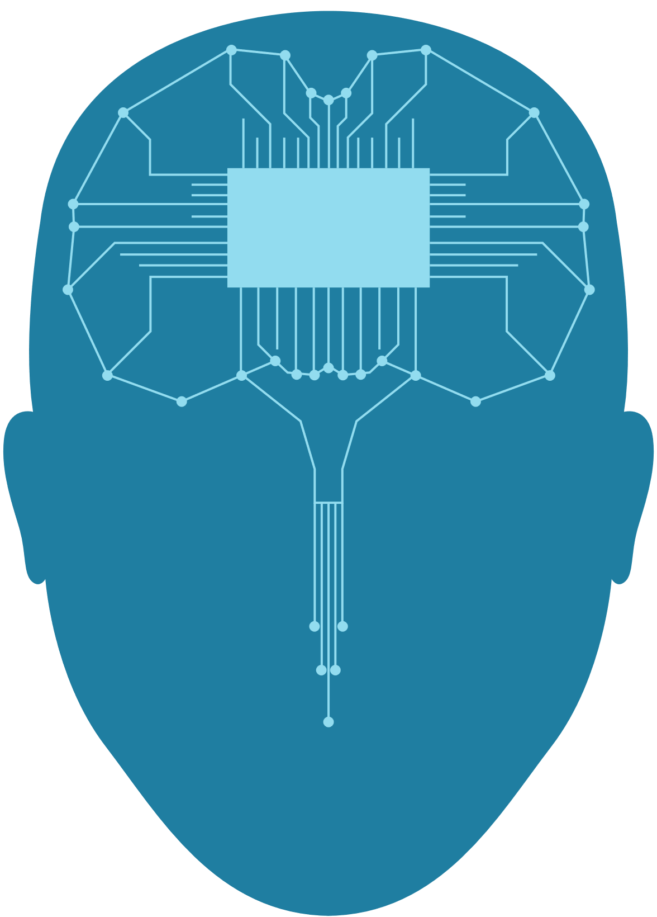
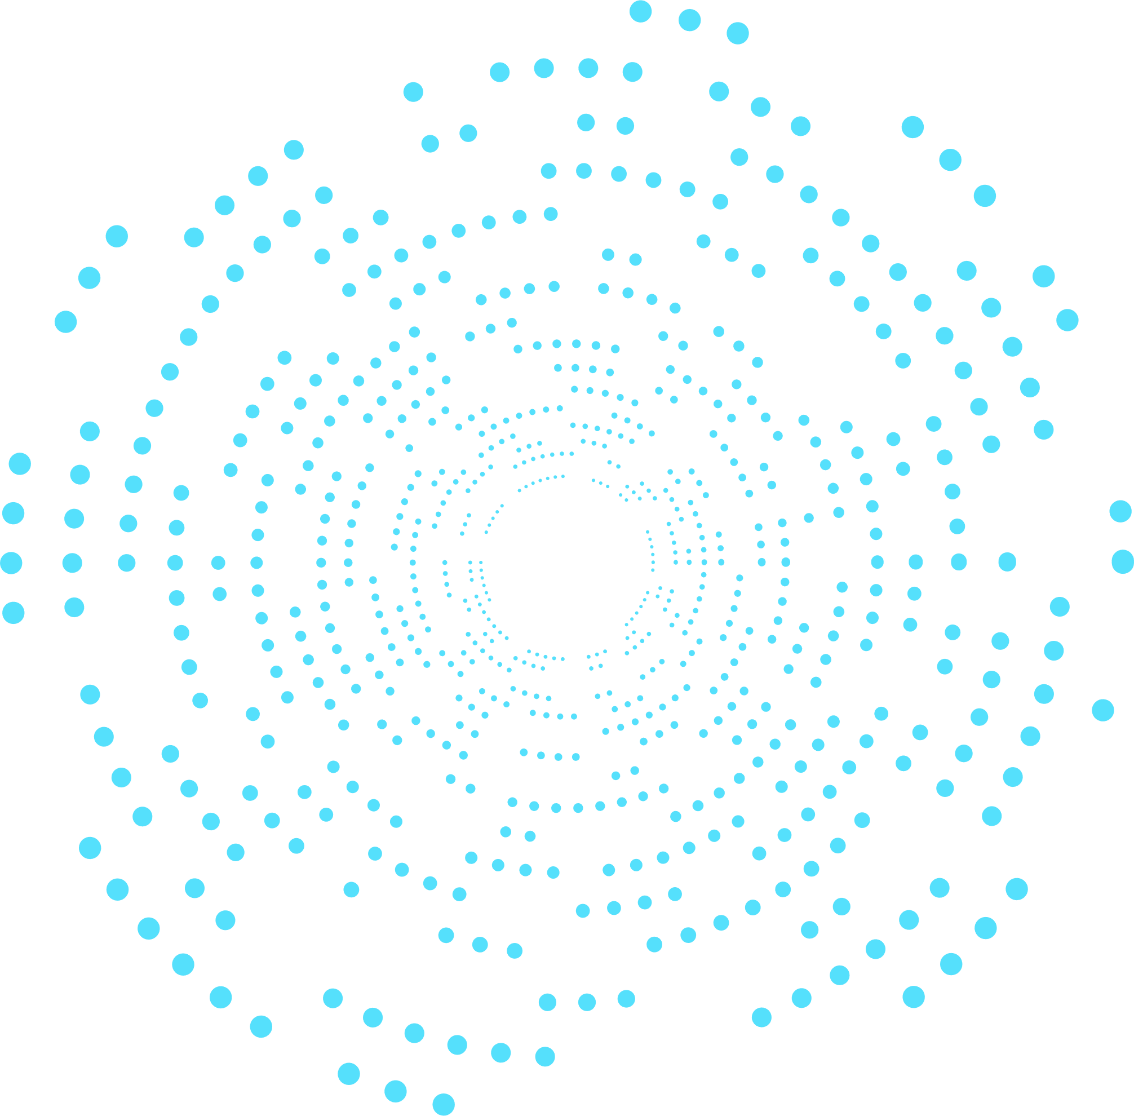



FACE
RECOGNITION
pitch deck by :
Newton.AI

Slide 2

TABLE OF CONTENT
EDA
01
Challenge
02
Exploratory Data Analysis
Problems that can be solved with our ways.
Experiment
Result
03
04
experiment with 3 algorithma
The result and evaluation

Slide 3
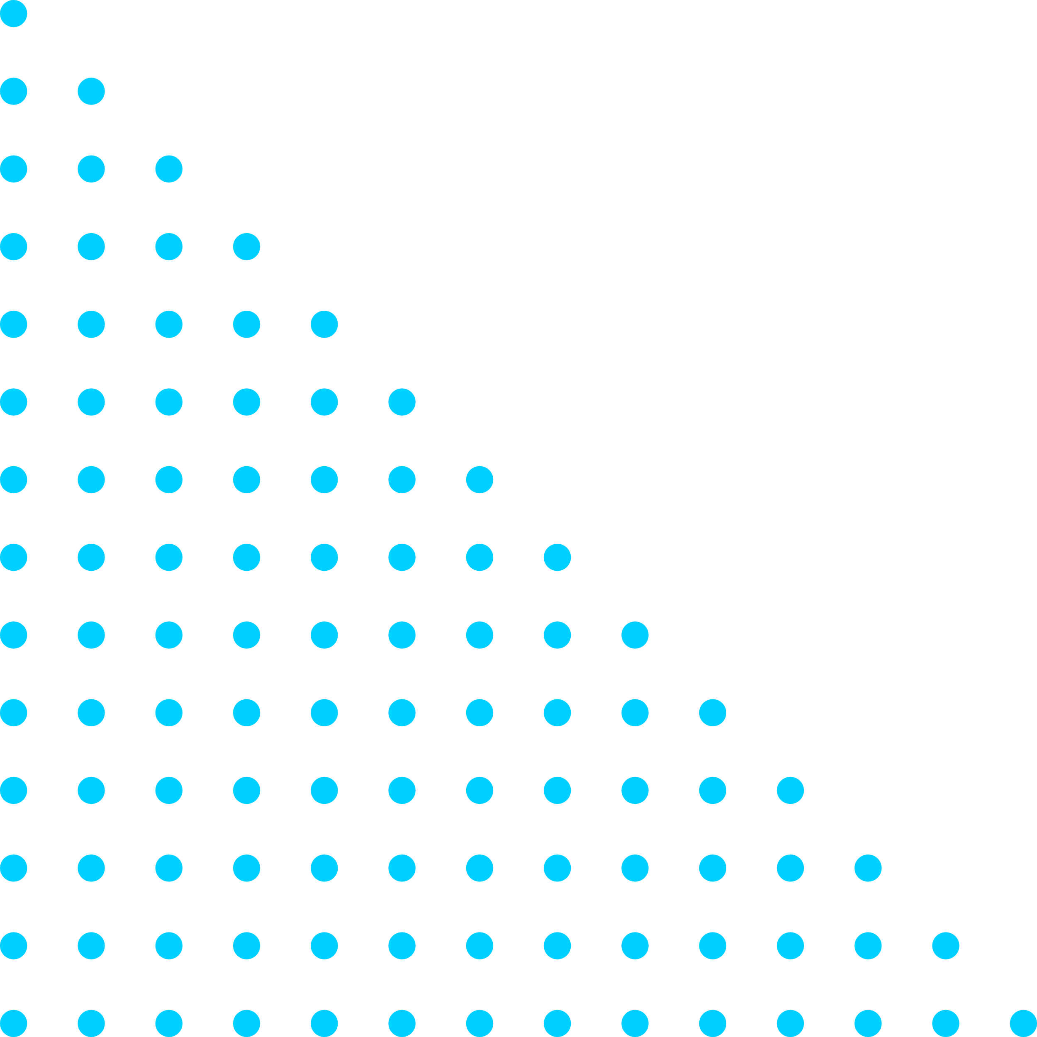

INTRODUCTION
Newton.AI adalah :
Nabilah Hannani
Bayu Wiryawan
Louis J Zhang
Aly Afandi
Edward
Syaiful Hasibuan

Slide 4
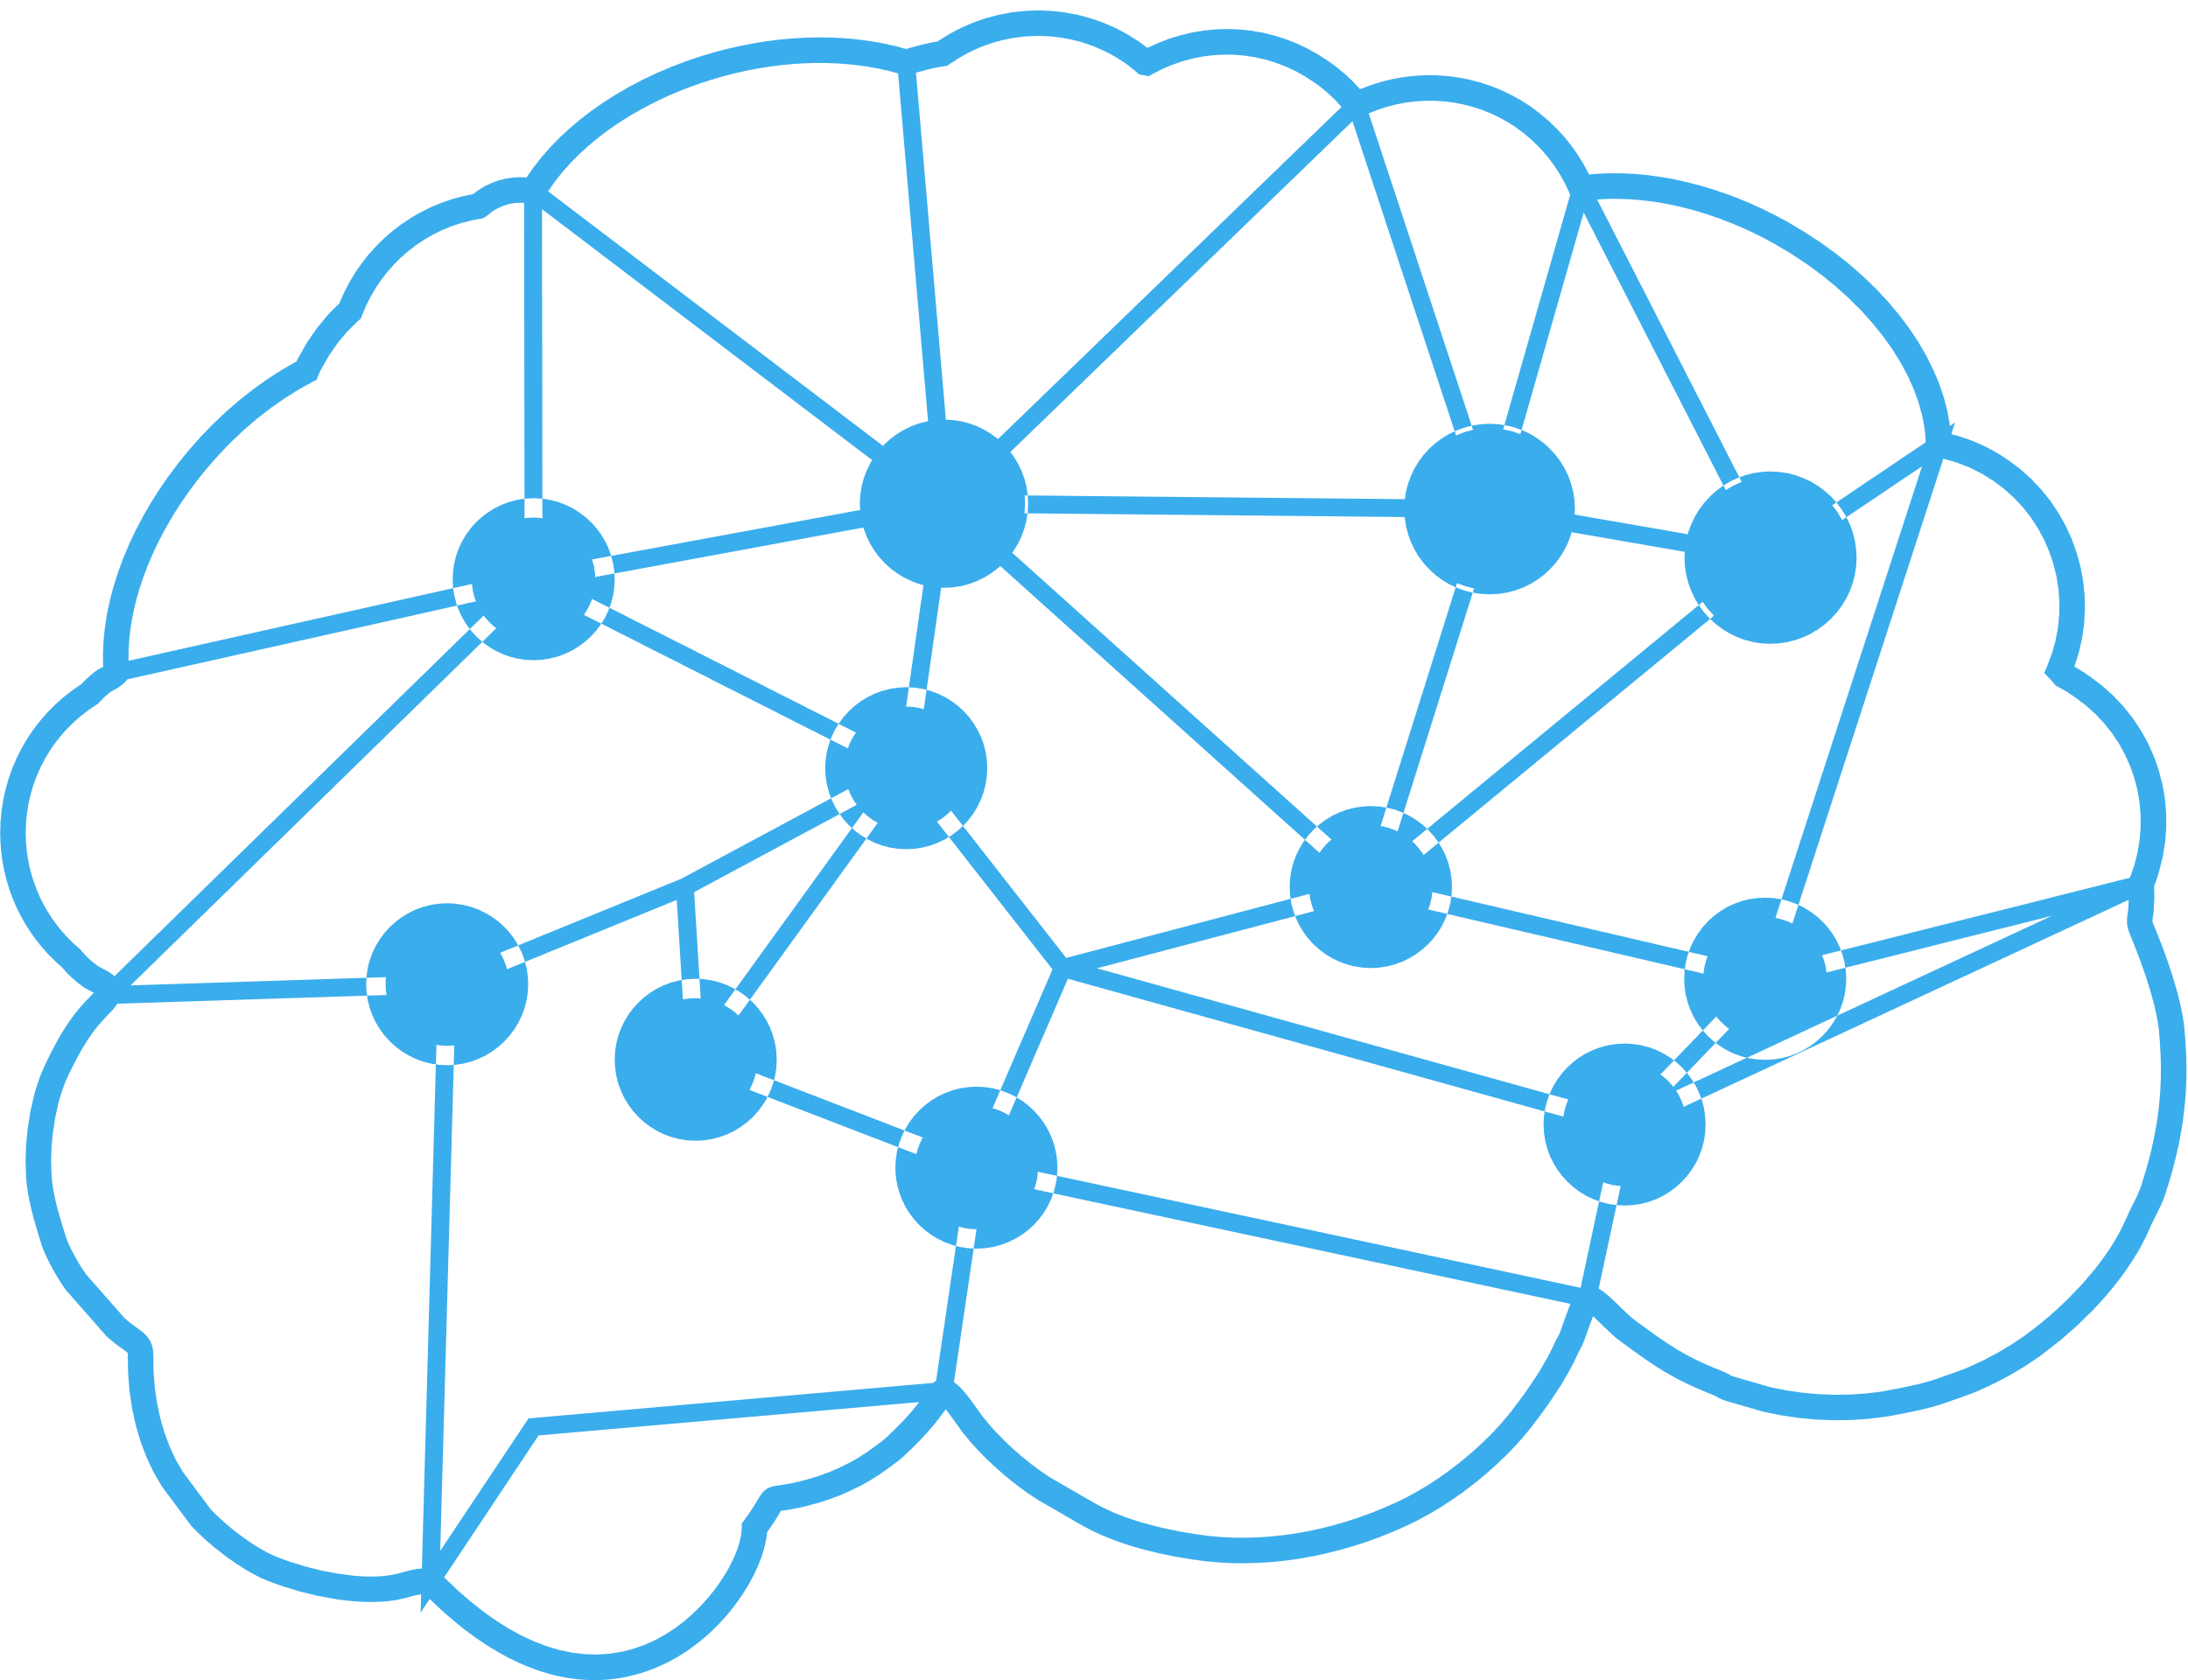


CHALLENGE
01
Mengenali wajah manusia secara otomatis yang bisa diterapkan pada sector healthcare, retail, education, surveilance, hr system dll
Aplikasi bisa dimanfaatkan utk kebutuhan, verifikasi, hak akses dsb.
TASK :
- MALE & FEMALE CLASSIFICATION

Slide 5


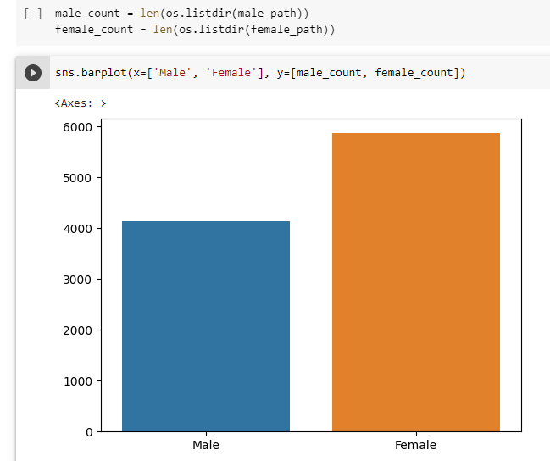
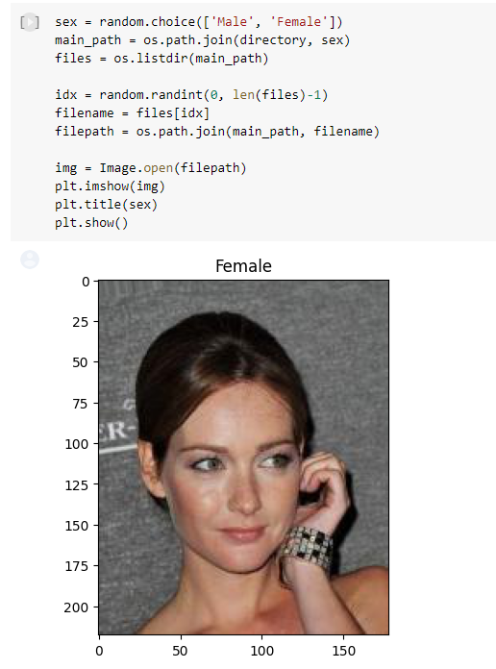
2
EDA
Split
Identification
blaaet dolore magna aliqua.

Slide 6
3
EXPERIMENT
 |  | RESNET |  |  | GoogleNet | VGG
 |  | 18 | 34 | 50 |  | 13 | 16 | 19
Validation Loss |  | 0.0846 | 0.0636 | 00797 | 0.0796 | 0.1151 | 0.6769 | 0.68
Akurasi Female | (%) | 97.27 | 98.08 | 97.16 | 98.83 | 96.13 | 100 | 100.0
Akurasi Male | (%) | 96.39 | 97.21 | 96.68 | 98.0 | 93.77 | 0 | 0.1
Akurasi Testing | (%) | 96.92 | 97.72 | 96.96 | 98.48 | 95.15 | 59 | 57.96
Interface time CPU | (s) | 0.0003 | 0.00032 | 0.00039 | 0.01848 | 0.534 | 0.608 | 0.813
Interface time GPU | (s) | 0.0033 | 0.00595 | 0.02241 | 0.00957 | 0.034 | 0.004 | 0.039

Slide 7
3
EXPERIMENT
Preprocessing
Splitting Data : 0.25 for test ratio
Image Transformation for training data
transforms.RandomHorizontalFlip(),
transforms.RandomRotation(10),
transforms.Resize((224, 224)),
transforms.ColorJitter(brightness=0.2, contrast=0.2, saturation=0.2, hue=0.1),
transforms.ToTensor(),
transforms.Normalize(mean, std)
Image Transformation for testing data
transforms.Resize((224, 224)),
transforms.ToTensor(),
transforms.Normalize(mean, std)
Model Architecture :
Pre trained model with image net
Hyperparameter
Batch Size : 32
Optimizer : Adam (default parameter)
Loss : CrossEntropyLoss

Slide 8
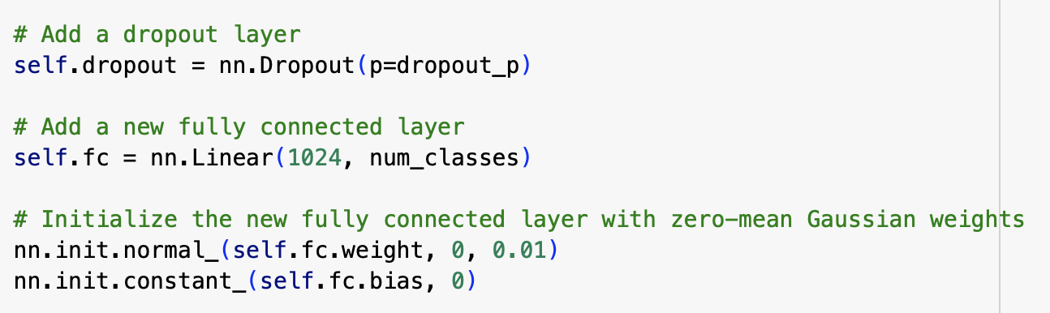
3
Best Model & Experiment
 |  | GoogleNet | GoogleNet (Modification)
Validation Loss |  | 0.0796 | 0.0852
Akurasi Female | (%) | 98.83 | 96.68
Akurasi Male | (%) | 98.0 | 96.78
Akurasi Testing | (%) | 98.48 | 96.73
Interface time CPU | (s) | 0.01848 | 0.00036
Interface time GPU | (s) | 0.00957 | 0.01040
Experiment on Google Net:
Preprocessing
Splitting Data : 0.4
Model Architecture
Add 1 dropout layer 0.5 before the fully connected layer
Hyperparameter
Batch Size : 16
Optimizer : SGD
optim.SGD(model.parameters(), lr=0.01, momentum=0.9, nesterov=True)

Slide 9
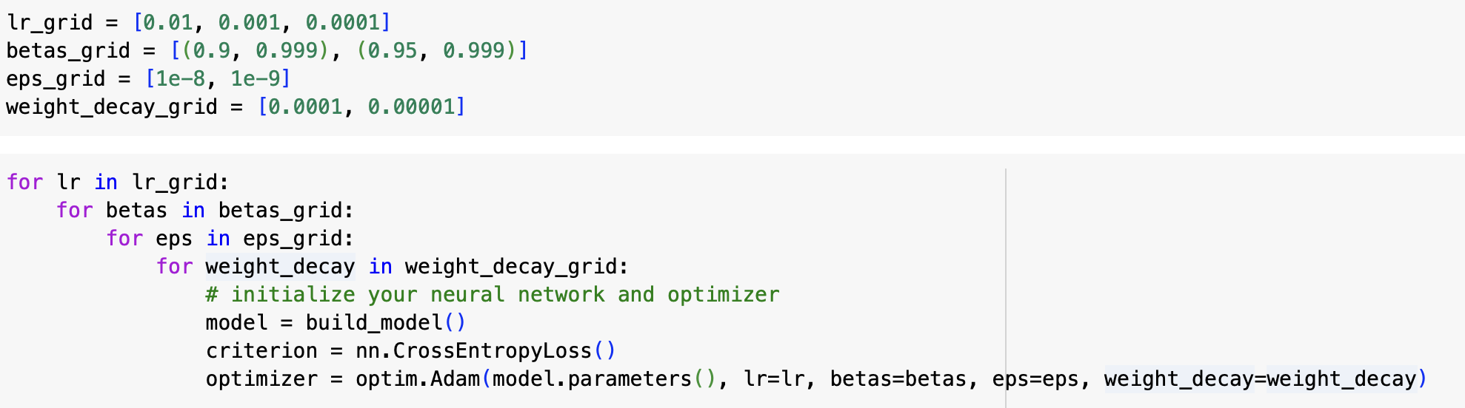
3
Best Model & Experiment
Experiment on Google Net:
 |  | GoogleNet | GoogleNet (Modification)
Validation Loss |  | 0.0796 | 0.0616
Akurasi Female | (%) | 98.83 | 97.95
Akurasi Male | (%) | 98.0 | 97.72
Akurasi Testing | (%) | 98.48 | 97.85
Interface time CPU | (s) | 0.01848 | 0.00069
Interface time GPU | (s) | 0.00957 | 0.01288
Hyperparameter
Batch Size : 16
Optimizer : Adam

Slide 10
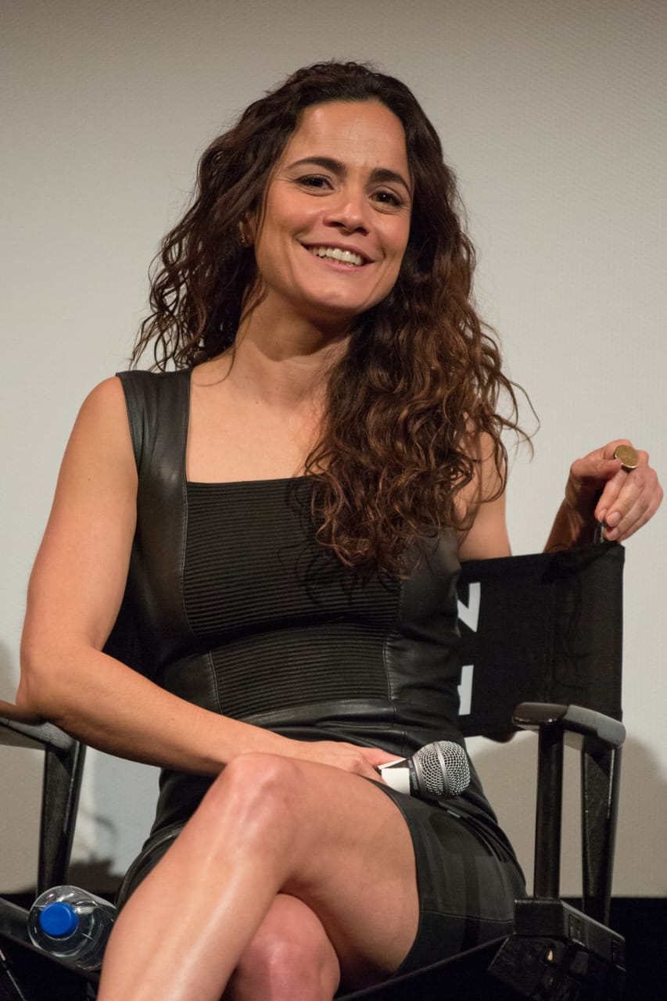



4
FACE DETECTOR

Slide 11
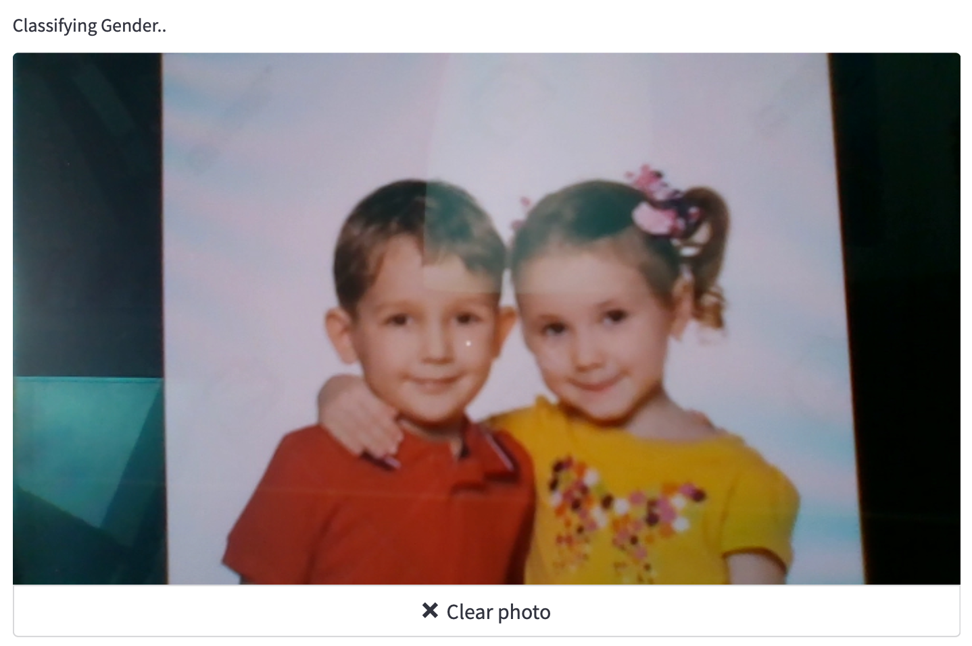
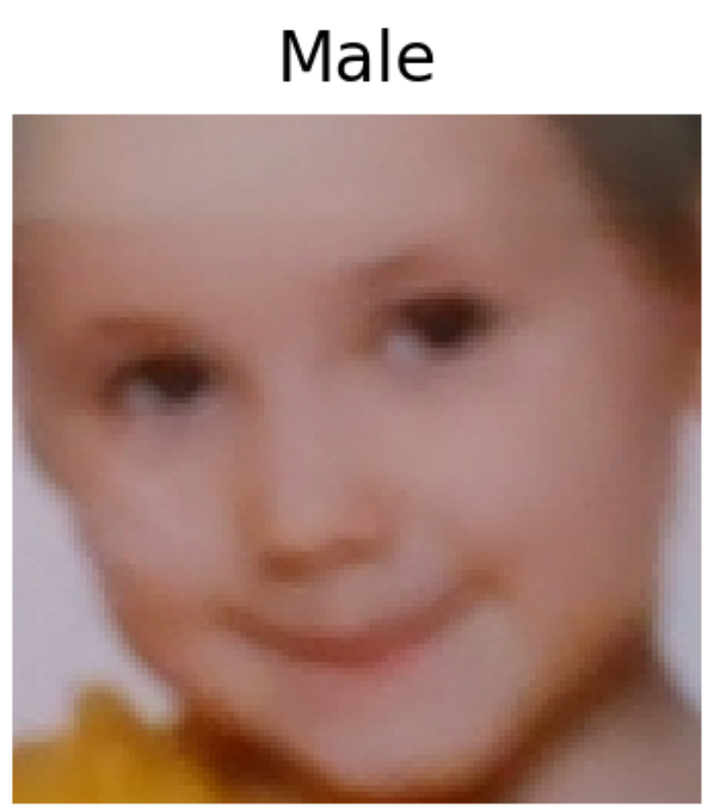
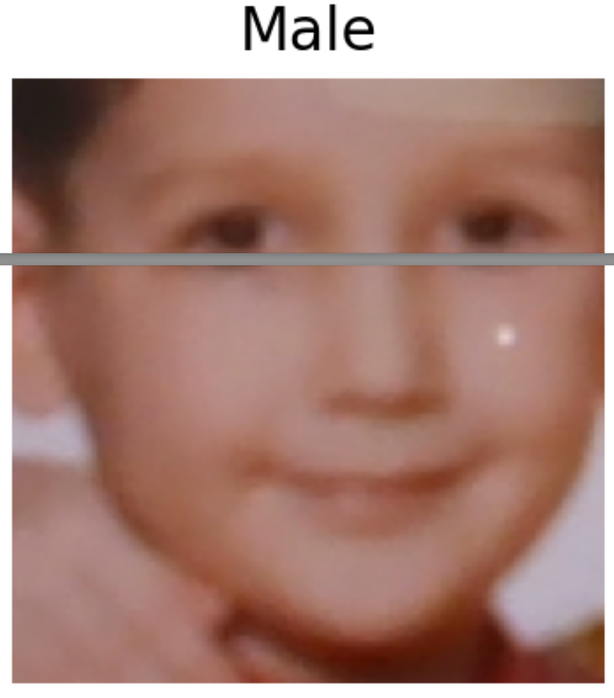
4
FACE DETECTION (No Margin)

Slide 12
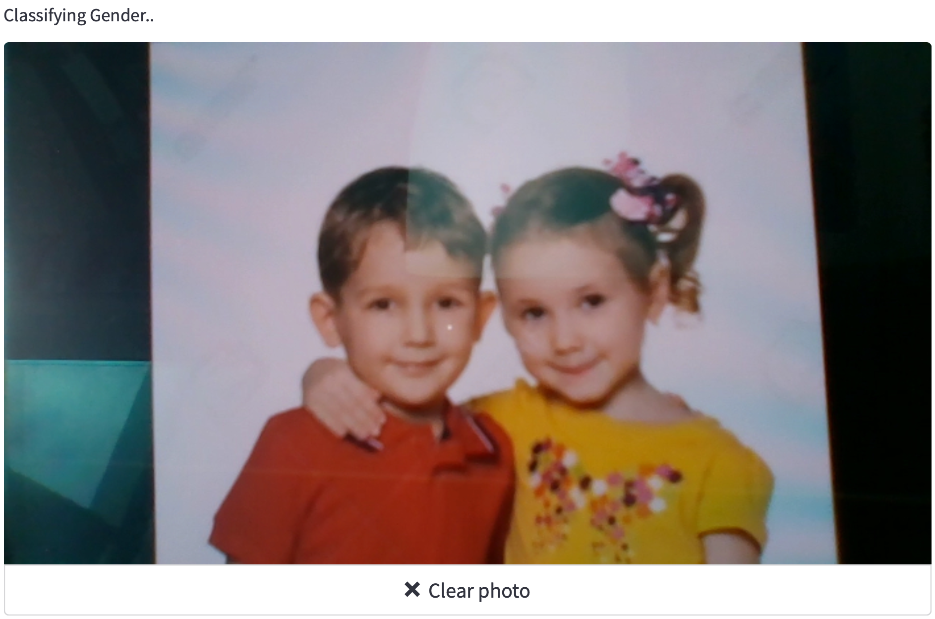
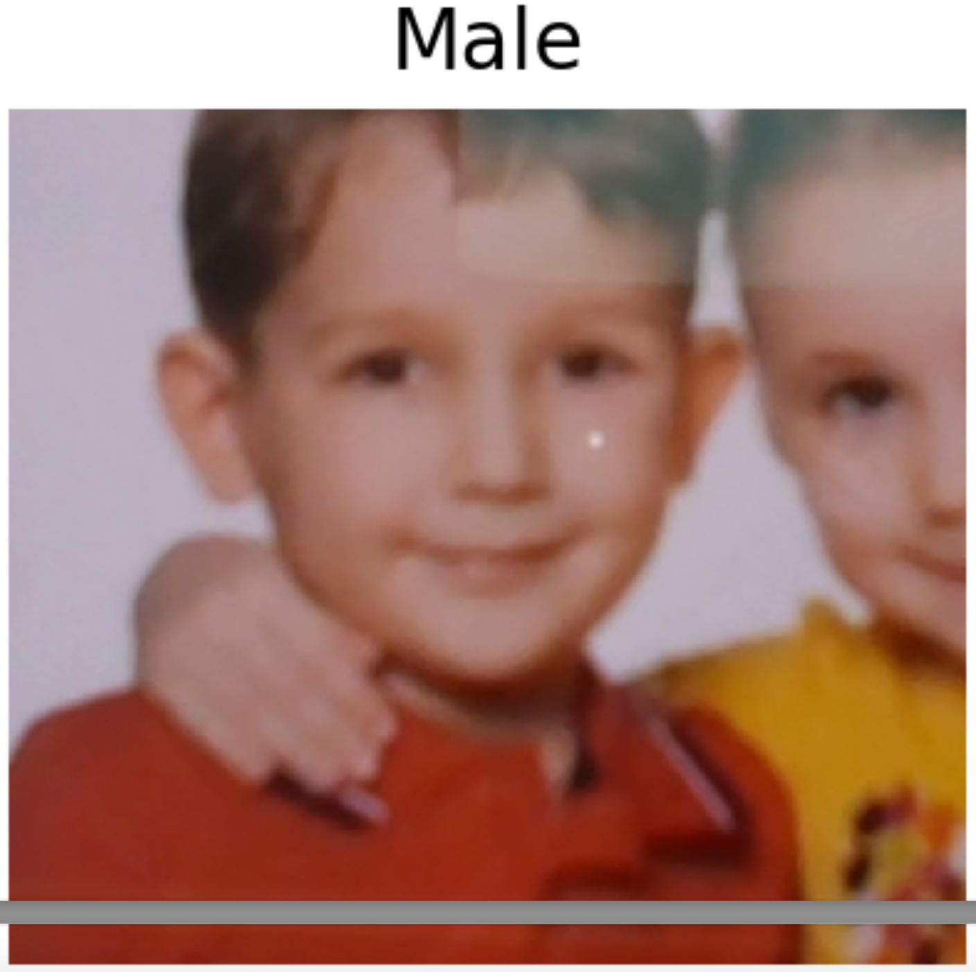
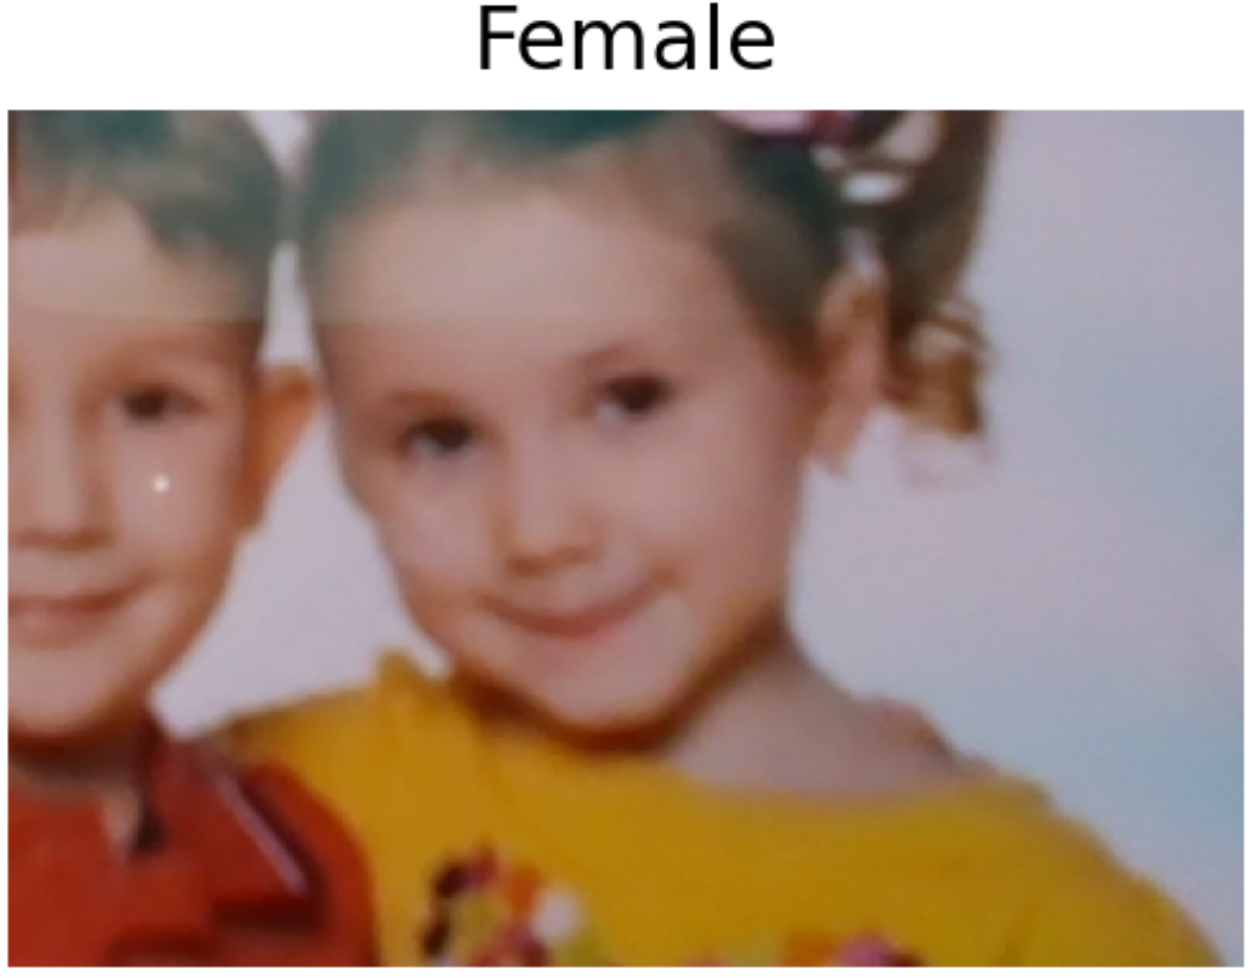
4
FACE DETECTION (+ Margin)

Slide 13
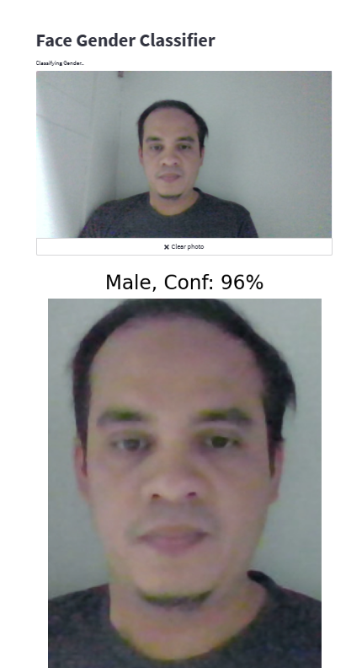
4
RESULT
https://newton-ai-gender-classifier.streamlit.app/

Slide 14
Thanks!

